Slide 1
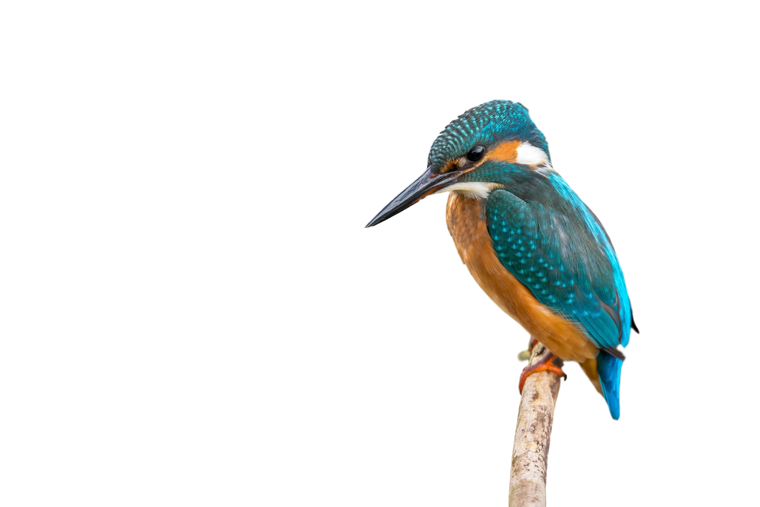
Welcome to Kingfisher class
Mrs Youngs and Miss Burgon

Slide 2
Expectations
Teamwork – in talk partners, groups and various roles
Respect – for others, equipment, themselves
Presentation including handwriting– to take pride in their work and learning
Personal responsibility – organising themselves, remembering equipment, passing on letters, remembering kits
Role model – setting an example of our values and behaviour expectations
Attendance

Slide 3
Friendships
Responsibility for behaviour
Growing in maturity
How do we make amends and react better next time?
Please let us know if your child is concerned about a friendship, or feels they are being treated inappropriately by others
In preparation for residentials, consider sleep-overs!

Slide 4
Routine
8:40 start to learning – activities as soon as they come in
PE kits for Monday
Swimming on Wednesday to include swimming hat and goggles (please avoid tights, socks are easier, hair plaited if possible)
Home learning: Thursday – due back Tuesday
Friday – Book of the Week
TTRS – online times table games
Google Classroom
Spellings – given on Thursday , checked on Wednesday

Slide 5
Daily equipment
Reading book & diary, some will have ‘level book’ and a reading for pleasure book
Water bottle
Morning maths / spellings
Named uniform

Slide 6
Help at home
Checking quality of home learning
Helping with organisation
TT Rockstars
Reading
Positive mindset and promoting resilience
Clubs – great for skills building

Slide 7
MTC
What is the Multiplication Tables Check?
The checks consist of 25 times tables questions. The questions will only be multiplication, and they will go up to 12×12.
There will be 6 seconds to answer each question.
The check will be taken online during school time.
There is no pass mark.
But why are times tables so important? Having rapid recall of times tables makes other areas of maths much easier. Having the tables secure frees up their working memory for newer, more challenging tasks at hand.
In the two-week period beginning 2nd June 2025

Slide 8
Contact
Through the office – 01707 322589 or admin@stjohns561.herts.sch.uk
A note via your child
A meeting before or after school (grab me at the classroom door at 3:15pm to organise!)

Slide 9
Thank you for your time

