Slide 1
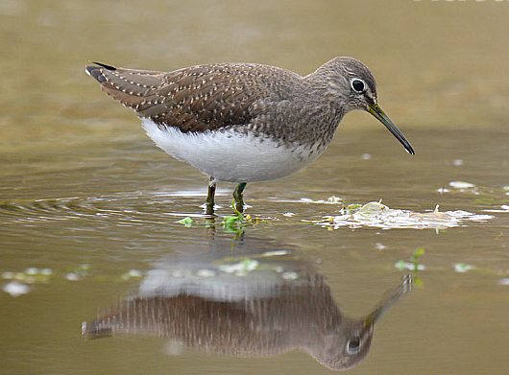
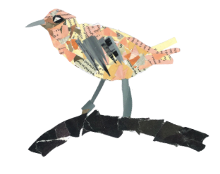
Welcome to Sandpiper Class!
With Miss Ng and Mrs Khiernyejad
Supported by Miss Noonan and Mrs Meola

Slide 2
Class 4 team
Miss Ng
Mrs K
Miss Noonan and Mrs Meola
All of you!

Slide 3
Expectations
Teamwork – in talk partners, groups and various roles
Respect – for others, equipment, themselves
Presentation – to take pride in their work and learning
Handwriting – neat, joined when possible, and in pen
Personal responsibility – organising themselves, remembering equipment, passing on letters
Role model – setting an example of our values and behaviour expectations to their buddies and the school
Attendance – incredibly important for their learning and wellbeing

Slide 4
Friendships and games
Responsibility for behaviour
Growing in maturity
How do we make amends and react better next time?
Please let us know if your child is concerned about a friendship, or feels they are being treated inappropriately by others

Slide 5
Routine
8:40am start to learning
Come to school in PE kits for Monday and Friday
Home learning: Tuesday: reading home learning and spelling– due Fridays Friday: English/Topic/Maths – due Wednesdays
Spelling journals
Friday – Book of the Week
Learning partners change weekly

Slide 6
Daily equipment
One pencil case – can have additional art/colouring one in bag if it doesn’t all fit
School planner
Reading book
Water bottle
Spelling journal
Named uniform!

Slide 7
Help at home
Checking quality of home learning
Helping them organise themselves while also building their independence
TT Rockstars and Eedi
Keep an eye on our Topic Web – perhaps weave in visits, conversations or research
Reading regularly and discussions around reading
Positive and resilient mindset
Clubs – great for skills building
Sleepovers!

Slide 8
Some upcoming events and dates
Parent Consultations
Year 5 fun
Book Look
Bike-ability
Year 6 health questionnaire
Dance Festival at Campus West
SATs for Year 6
Residential trip
Puberty education

Slide 9
Contact
Through the office – 01707 322589 or admin@stjohns561.herts.sch.uk
A note via your child
A meeting before or after school
Or grab me on the playground at 8:40am and 3:15pm to pass on a quick message or make an appointment

Slide 10
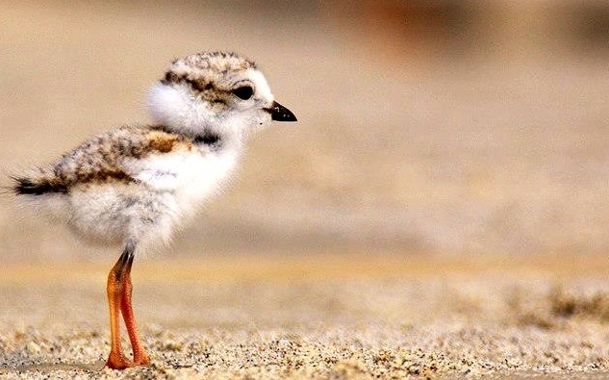
Thank you for joining!
Any questions?

