Slide 1
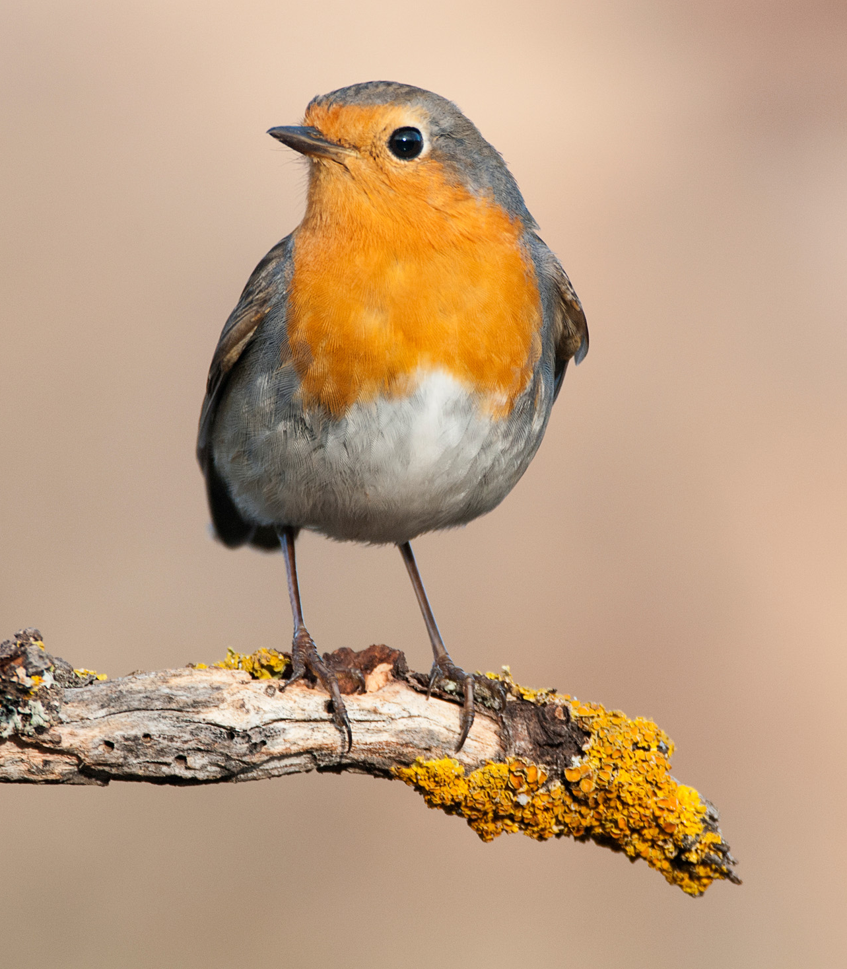
Welcome to Robins
With Miss Mockford, Mrs Redmond,
Mrs Hoad, Mrs Simone and Mrs Wallace

Slide 2
Routine
8:40 start to learning – busy fingers
Saying good-bye to parents at the playground door from now.
PE kits – PE is on a Monday. Children will work up to changing into their full PE kit and children will go home in their PE kits on Monday with their uniform in their bag. Please make sure that the kit is returned by the Friday.
Home learning:
Reading at least 5 times a week. Adults to comment on
how they did in Reading Record. Home learning opportunities on MTPs. First homework of photos already sent out.

Slide 3
Expectations for Robins
Teamwork – in talk partners, groups and during child initiated learning
Respect – for others, equipment, themselves, the school,
Presentation – to take pride in their work, to explore the setting which may include a little mess! Remember to wear their outside clothes, wellies and aprons.
Handwriting – Practising pattern formation and correct letter formation.
Personal responsibility – organising themselves, remembering routines, remembering their belongings.

Slide 4
Tapestry
Observations will be placed on this system to show what your child is learning at school.
Used as a way of communicating about upcoming events and notes from school – please check regularly.
Please add any life events or special occasions onto Tapestry for children to share with the class.
For your own personal use – please do not share outside your household.

Slide 5
Things to remember everyday
Book bag with reading record and book in.
Jacket/Coat
Water bottle
Library books (on a Monday)
Please label everything!
Waterproofs and wellies (to stay on peg in school- in a name bag please) We will send home once a term to check it all still fits well.

Slide 6
Help at home
Encouraging independence with dressing, toileting and eating.
Practise letter sounds and reading daily – pure sounds only please!
Encourage drawing and mark making including outside chalking.
Recognising numbers in the environment, counting out objects eg: setting dinner places
Encourage building upper body strength – monkey bars, climbing, pilates poses.
Fine motor skills – bottle lid twisting, threading, pegs, picking up coins from a table, posting buttons through a hole, pencil control

Slide 7
Upcoming dates and meetings
Individual photos: Thursday 12th September
Harvest service at St John’s Church: Sunday 6th October
Parents’ Evening (online): Tuesday 22nd October
Parents’ Evening (face-to-face): Thursday 24th October
Christmas Panto: Monday 9th December
Christmas Nativity: Thursday 12th December (2:30 and 5:00pm)
Lemsford Fete: Monday 5th May
End of terms finish at 1:30pm

Slide 8
Contact
Through the office – 01707 322589 or admin@stjohns561.herts.sch.uk
Speak to Mrs Boylan on the gate- any messages will be passed on
A note via your child/on Tapestry
A meeting before or after school
Or just grab us at the classroom door at 8:40am and 3:10pm
Please think which of these will work best

Slide 9
Thank you for listening
Any questions?

