Slide 1
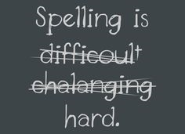
Parents’ information session
- No Nonsense Spelling introduction
- Handwriting and presentation

Slide 2
Why does spelling matter?
Increased expectations within the 2014 curriculum (See end of presentation for the statutory spelling lists for each year group).
Spelling errors are noticeable and off-putting e.g. applications, CVs, essays, emails etc.
Lack of spelling confidence can lead to self-imposed limitations in writing
Confident spellers with fluent handwriting are free to focus on composition and effect.

Slide 3
Becoming a confident speller
Children need multiple and meaningful exposure to spellings
Just once through, such as memorising words for a test, does not offer multiple and meaningful exposure
Children need to interact with the words, rules and exceptions

Slide 4
No Nonsense Spelling
Written by a team of consultants in Devon who considered factors such as age, types of words children need to learn and how children learn.
Focuses on:
The teaching of spelling: knowledge of rules, patterns and exceptions
The learning of spellings: statutory words, common exception words, topic based vocabulary

Slide 5
No Nonsense Spelling
Children are taught from Year 2 in individual year groups to focus on the age-related and key stage specific spelling curriculum.
Children are ready for NNS when they have passed their Year 1 Phonic Check and are secure at Phase 5 Letters and Sounds (taught in Year 1). This gives them a solid foundation to progress onto new spellings and rules.
They use their spelling journals to record their lessons and practise. These are not formally marked by teachers.

Slide 6
No Nonsense Spelling
Short, sharp lessons in spellings – for Year 2 these are daily, in Class 3 and 4 they are 3x a week.
Children are taught a range of strategies and approaches to learning spellings. (See end of presentation for list of strategies used in school that could also be used at home)
They have multiple exposure to spellings and rules.
While children are guided by teachers, they take ownership over their learning.

Slide 7
Lesson types
Revise: Look at our prior knowledge and revisit previous learning.
Teach: Introduce and explain a new concept and spend time investigating and modelling.
Practise: Using games and strategies – may be individually or in groups.
Apply/assess: Apply independently. Children to explain and demonstrate their understanding.

Slide 8
Handwriting
Common issues we see:
Poor grip or heavy pressure
Writing off the line/away from margin
Ascenders and descenders not at correct height
Capital letters used within words
Letter formation is unclear
Poor fine and gross motor skills

Slide 9
Handwriting facts
A British survey found that approximately 40% of people hadn’t handwritten in six months (2014)
26% of people hadn’t sent or received a handwritten letter in a decade (2018)
Over two thirds of 25-35 year olds use a pen less than five times a week. Three quarters rely on autocorrect to check their spellings. A quarter prefer using emojis rather than words to express feelings or communicate.
Learning spellings by hand supports accurate recall and recognition when both reading and writing

Slide 10
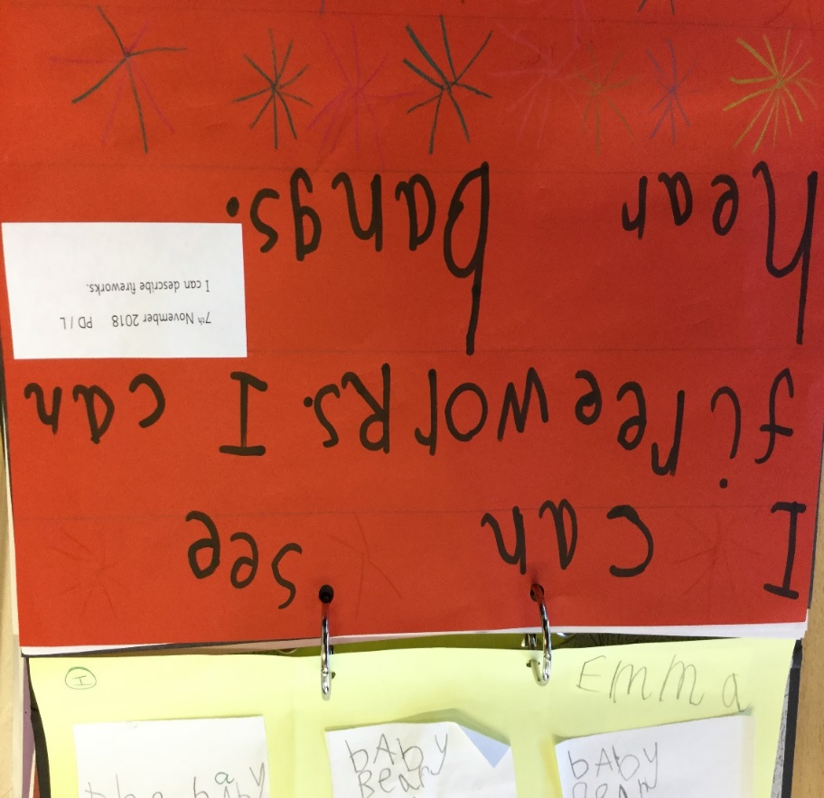
Handwriting through the years
EYFS: fine and gross motor skills, position and grip, letter formation (starting point for each letter), ascenders, descenders, linking sounds and shapes, upper and lower case

Slide 11
Years 1-2: securing consistent letter size and formation, spacing, writing on the line, learning joins and some beginning consistent cursive

Slide 12
Years 3-4: continuing practise with cursive writing (unless printed is necessary), interventions when necessary

Slide 13
Years 5-6: continuing with cursive handwriting at speed, some developing own style

Slide 14
Advantages to cursive
Children develop a physical memory to writing and spelling
Letters and words flow from left to right – less likely to reverse letters (b/d, p/q)
Clear distinction between upper and lowercase
Helps children’s writing be fluent, legible and fast
Pencil is not lifted from the page – this reinforces phonic and spelling knowledge
Pride in presentation

Slide 16
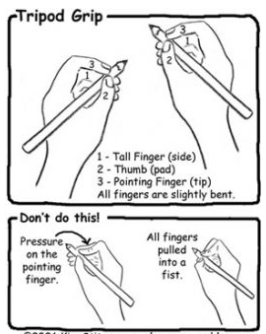
Aiming for a tripod grip
Some children apply a lot of pressure on their ‘pointer’
Some grip the pencil/pen with all four fingers along the side

Slide 17
Support at home Handwriting and spelling
Encourage their age-related expectations
Focus first on formation, then size, then joining
3 Ps – posture, pencil grip, paper
Little and often – intertwine the two in their spelling journals
Reinforce and reiterate school expectations in homelearning – neat, appropriate tools for the job

Slide 20
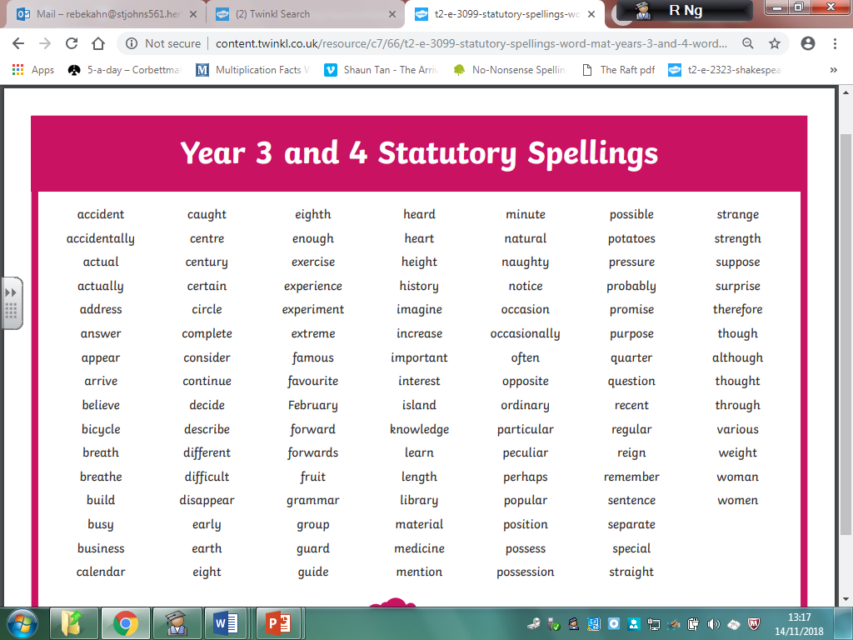

Slide 21
