Slide 1
Teach reading, change lives
Little Wandle parent information session
3rd October 2022

Slide 2
A love of reading is the biggest indicator of future academic success.
OECD (The Organisation for Economic Co-operation and Development)

Slide 3

Reading Statistics
Children who are read to at least 3 times a week by a family member
Reading for pleasure is more important for children’s cognitive development than their parent’s level of
Children who read books often at age 10 and more than once a week at age 16 gain higher results in maths,
are almost twice as likely to score in the top 25% in reading.
vocabulary and spelling tests at age 16 than those who read less regularly.
education and is a more powerful factor in life achievement than socio-economic background.
Kristin Denton, Education Statistics Services Institute
Jerry West, National Centre for Education Statistics
[McGrane et al. (2017) Progress in
International Reading Literacy Study (PIRLS):
National Report for England p. 16]
[OECD (2010) PISA 2009 Results: Learning to Learn:
Student Engagement, Strategies and Practices p. 32-4]
Young children whose parents read them 5 books a day enter Reception
Children read to more frequently at age 4-5 achieve higher scores on the National
having heard about 1.4 million more words than children who were never read to.
Assessment Program in reading and Numeracy in Year 3 (age 8-9).
Jessica A. R. Logan, Laura M. Justice, Melike Yumuş, Leydi Johana Chaparro-Moreno. When Children Are Not Read to at Home. Journal of Developmental & Behavioral Pediatrics, 2019;
Reading to young children: a head-start in life, authored by: G. Kalb and J.C. van Ours.

Slide 4
Phonics is:
making connections between the sounds of our spoken words and the letters that are used to write them down.
Notes:
It sounds complicated but it really isn’t!

Slide 5
Terminology
Phoneme – The sound the letter makes
Segment – pulling the sounds in words apart to write
Grapheme – How the sound is written
Digraph – 2 letters together that make one saound – EG: sh, ch, ng
GPC – Grapheme-Phoneme correspondance – The relationship between the written letters and the sound it/they make
Split vowel digraph – two vowels that are split by a sound in the middle. EG: cake - a_e is the split digraph.
Blend - Putting phonemes together to read
Trigraph – 3 letter together that make one sound. EG: igh
Notes:
Explain what each word means – use our glossary to help: https://www.littlewandlelettersandsounds.org.uk/resources/my-letters-and-sounds/getting-started/

Slide 6

Reading in school

Slide 7
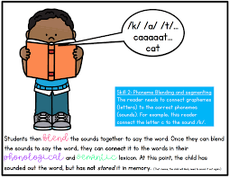
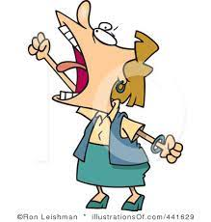

Your child will read 3 times a week with a trained adult.
Each reading session will focus on a different skill.
The children will read the same book each time and also take this book home.
Session 1 - Decoding
Session 2 – Prosody
(reading with expression)
Session 3 - Comprehension

Slide 8
Reading at home

Slide 9

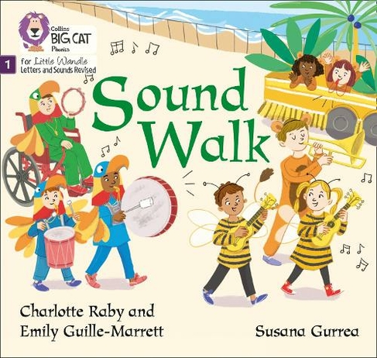

Reading bands
Please note: the colour bandings you are familiar with have changed with this program and will no longer apply in Reception and Year 1.
The Little Wandle books are banded to match the five phonic phases.
Phase 1 - Purple
Phase 2 - Pink
Phase 3 - Blue
Phase 4 - Green
Phase 5 - Yellow
Notes:
The children read the same book three times in a week. The first time we work on decoding (sounding out) the words, the second time we work on prosody which is reading with expression – making the book sound more interesting with our story-teller voice or our David Attenborough voice – and the third time we look at comprehension. We read the books three times at school because we want to develop the fluency. The more they see words the more they begin to read them automatically without having to sound them out.

Slide 10
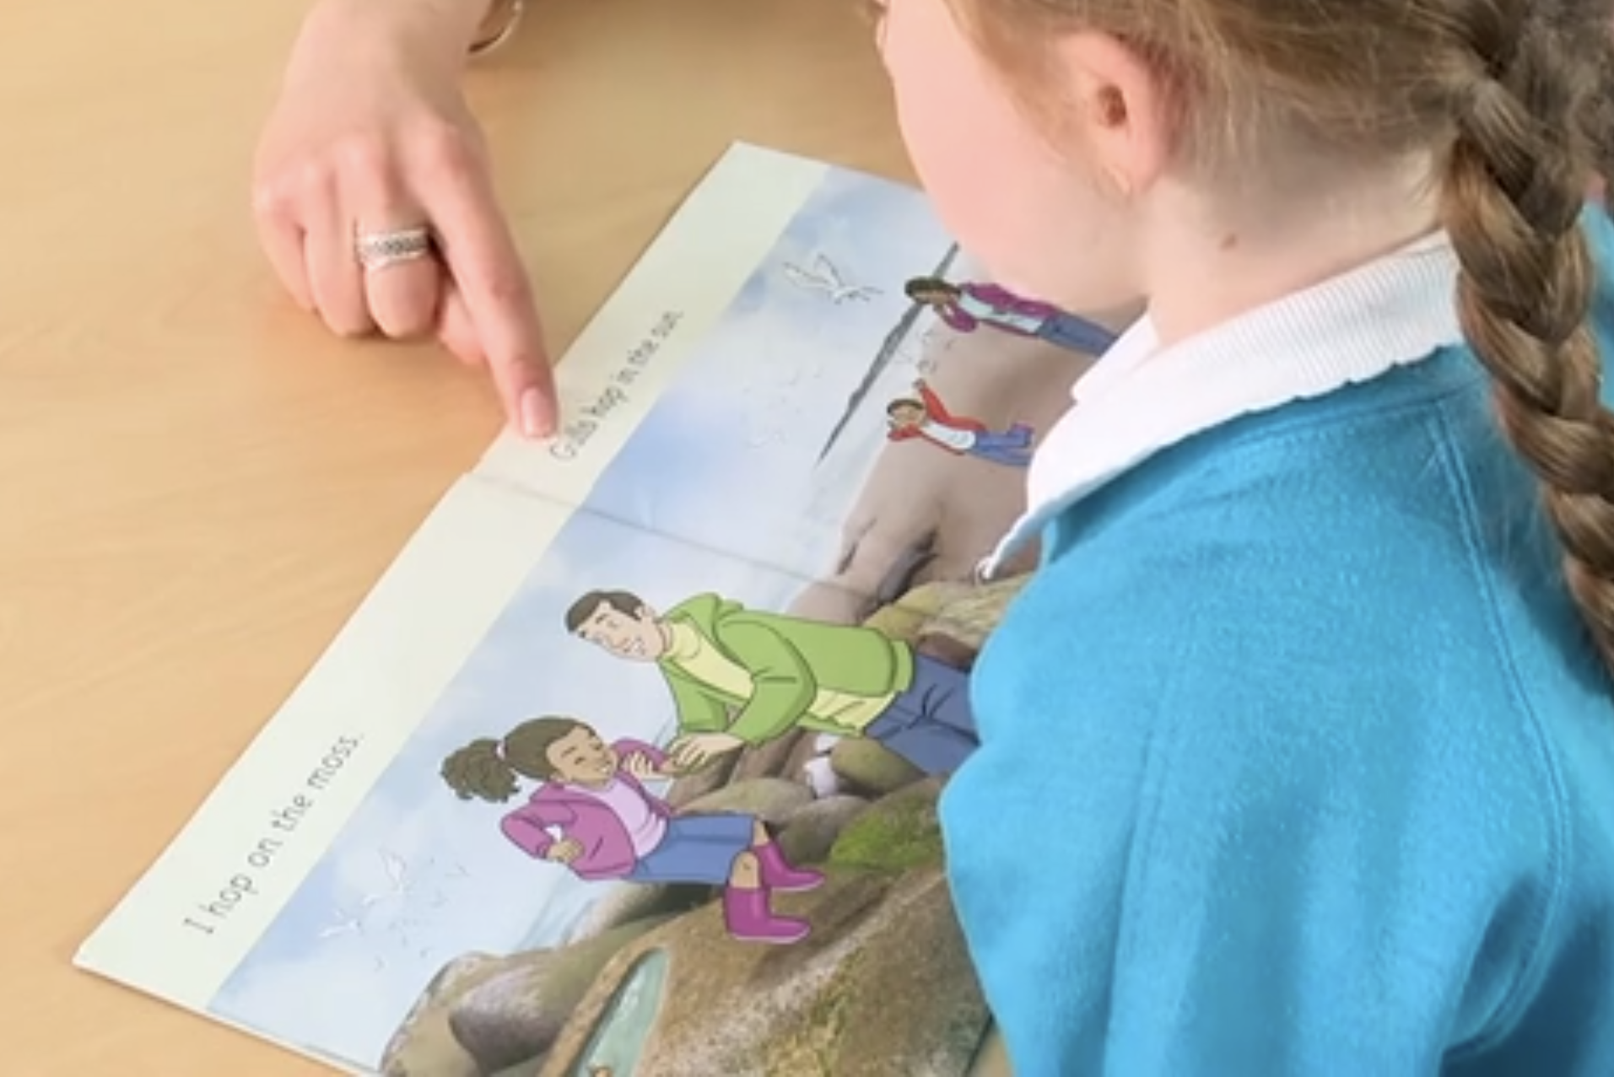
Reading a book at the right level
This means that your child should:
Know all the sounds and tricky words in their phonics book well
Read many of the words by silent blending (in their head) – their reading will be automatic
Only need to stop and sound out about 5% of the words by the time they bring the book home – but they should be able to do this on their own.
We want the children to feel secure in their reading by the time they have their 3rd adult led session in school. This way, they are able to reduce their cognitive load and focus on the comprehension! If your child seems confident at home with the book – this is a good thing!

Slide 11
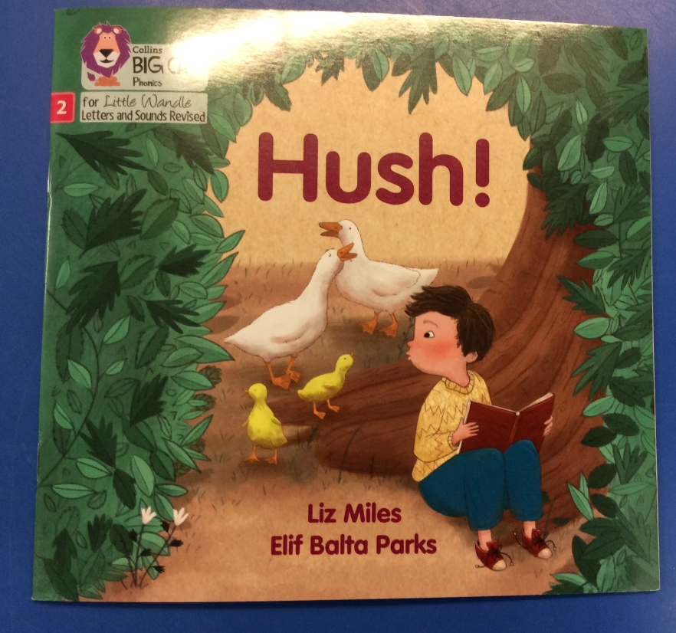
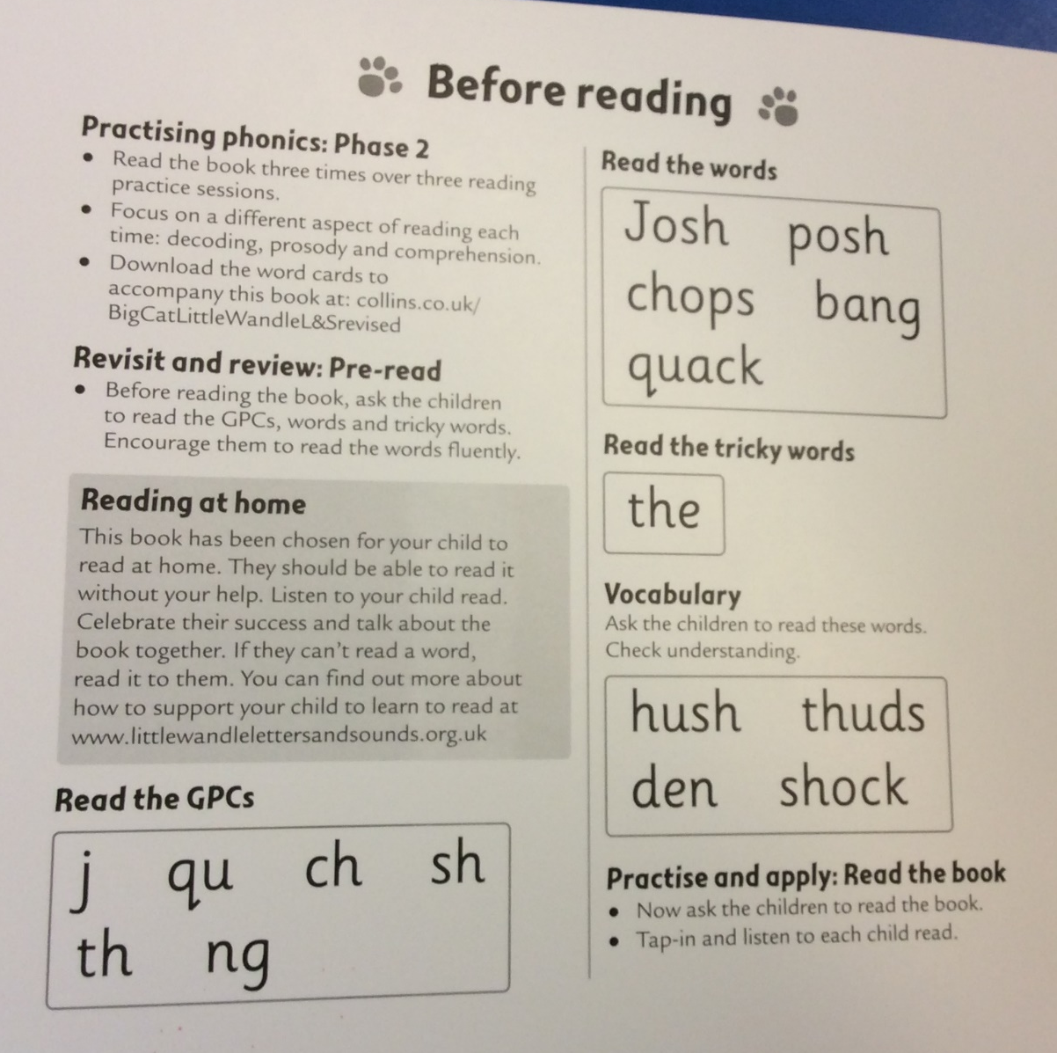
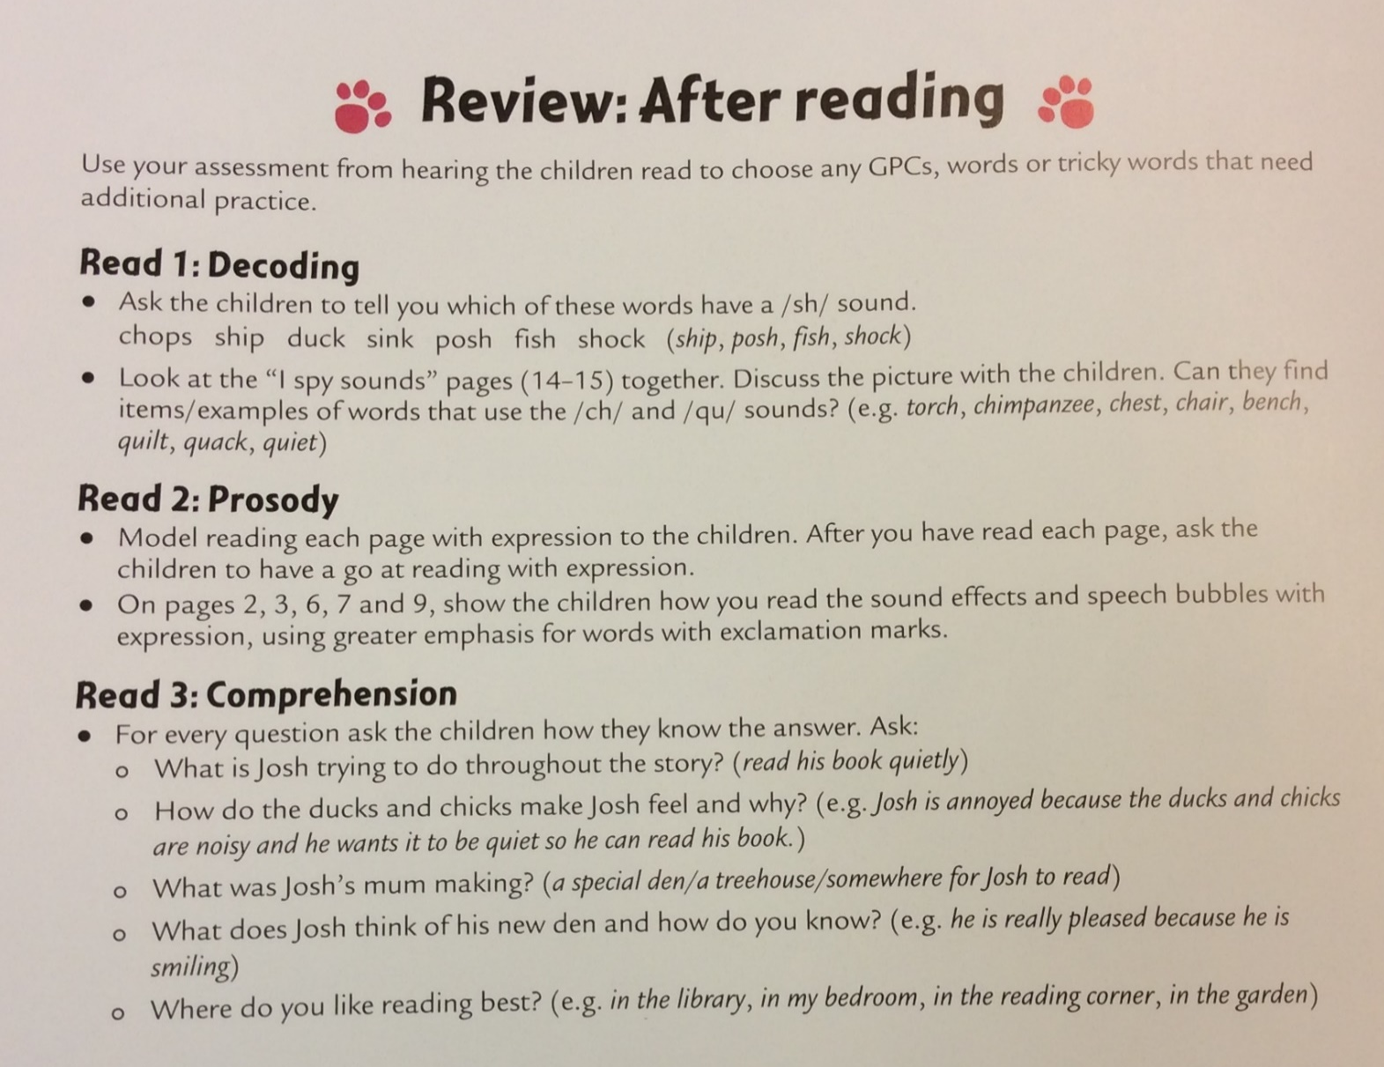
Inside the book

Slide 12
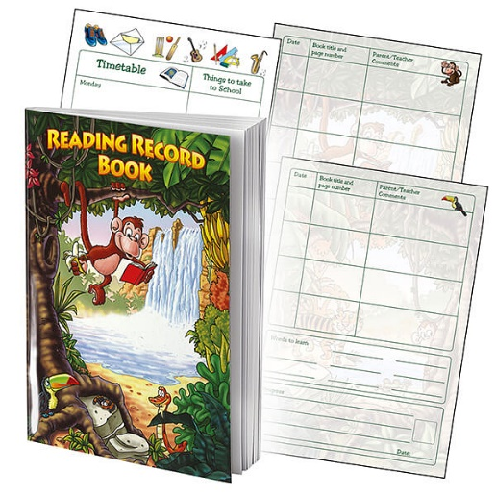
Home-School Communication
We would like your child to read at least 5 times a week, for at least 10 minutes each time.
Each time your child reads, please tell us how they did. This may be a note to say what words they struggled with or what you focused on. It would be helpful to think about the 3-part reading/teaching sessions when filling in the comments.
e.g. : X needed help to read words with ‘s’ on the end.
: I modelled how to read with expression. X did a great job of copying me and we spoke about why we read it this way.

Slide 13

Books going home
We have made a large investment in new sets of books to match the
progression within Little Wandle.
If these books get lost or damaged we will be asking for a donation of the cost of a replacement book. This is £4.50 per book.
Notes:
As well as the ‘learning to read’ book that your child will bring home they will also bring home a book for sharing with you. This book is SO important. This is how we are going to give them the WILL to read. Please read with your child as often as you can – at least once a day if possible.

Slide 14
How can I help with my child’s reading?
Remove all distractions – find a quiet, comfortable place to read.
Learn the phonemes.
Use the prompts in the book.
If your child says the sound wrong, model how to say it correctly.
Read the book yourself.
Have a focus – don’t try and fit everything into 10 minutes.
Be positive. Celebrate your child’s successes.
We will use the same book the children take
home in all 3 adult led sessions in school. Please make sure your child keeps their book in their bag each day.

Slide 15
Suggested reading week
Day 1 – Read the whole book after looking at key sounds, words and tricky words.
Day 2 – Read the book to your child and they copy the prosody.
Day 3 – Read the book with prosody independently.
Day 4 – Read the book and talk about what is happening with your child.
Day 5 – Read the book and ask comprehension questions.
Please note: before any reading session, it is really helpful to recap the key sounds, words and tricky words they will find in the book, which are on the inside of the front cover of the book.

Slide 16
Reading beyond Year 1

Slide 17
Reading in Year 2
Phonic decoding skills must be practised until children become automatic at recognising and blending all GPCs and fluent reading is established.
It is common for children to be unable to read with prosody when they are learning to read – they are not reading at a fast enough rate to think about what they are reading as they read.
Fluency assessments begin in the Spring term and will continue until the Summer term. These assess speed and accuracy!
Children in Year 1 should be reading at 60–70+ words per minute at the end of the programme, with a 90% accuracy rate.
A reading speed of 90 words per minute is required to integrate comprehension whilst reading (Armbruster et al, 2001).

Slide 18
Reading in Year 2 (Cont.)
Continued reading instruction in Year 2 is therefore crucial in order to teach fluency and enable children to become readers for life.
If children have not secured sufficient fluency and phonic knowledge by the end of Year 1, they will continue to read at least three times per week, in ‘reading practice’ sessions, using Little Wandle fully decodable books.
When children have achieved sufficient fluency and secure phonic knowledge, they will still have three sessions of guided reading instruction with an adult per week but will be using a range of non-Little Wandle, age-related texts chosen by their teacher.
They will continue to work on developing their fluency and prosody but will focus more heavily on comprehension skills.

Slide 19
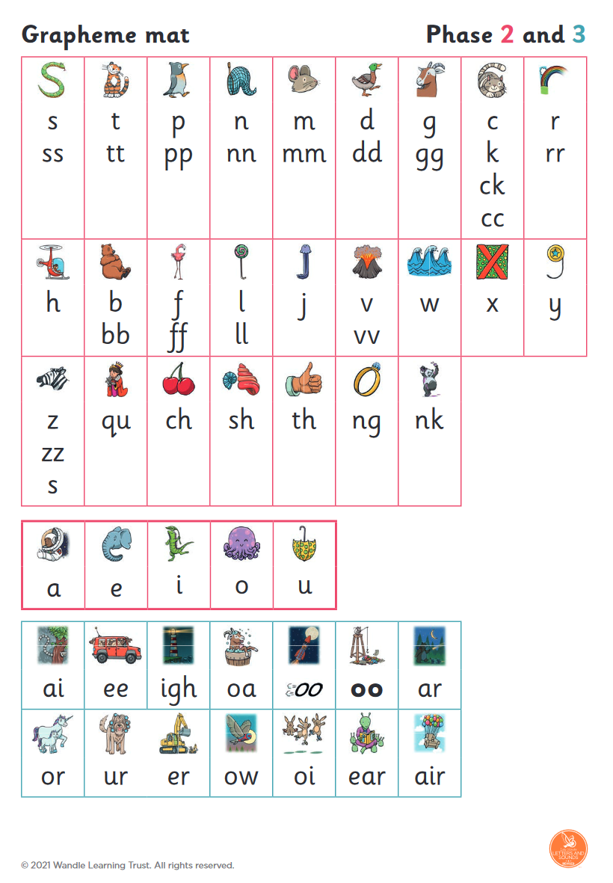
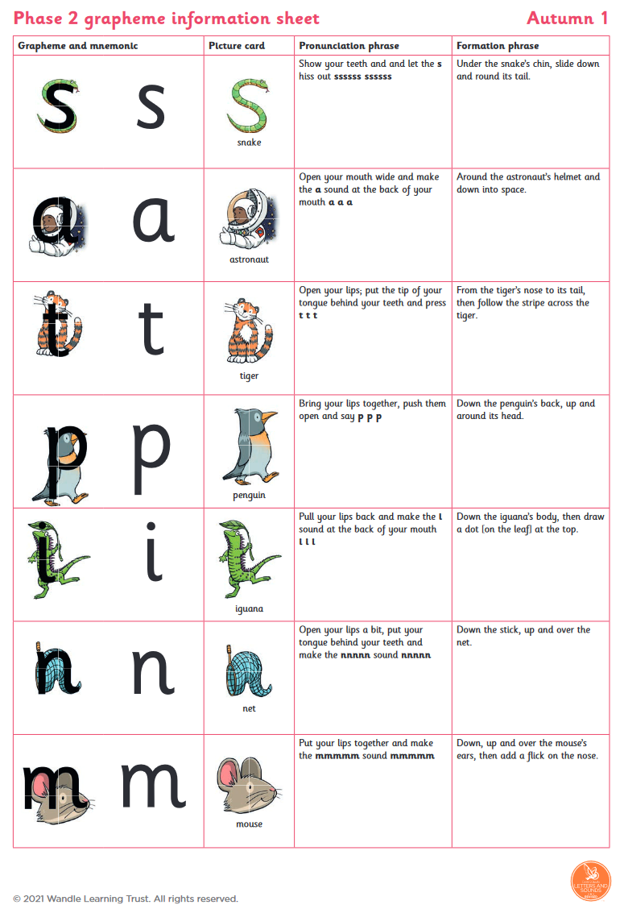
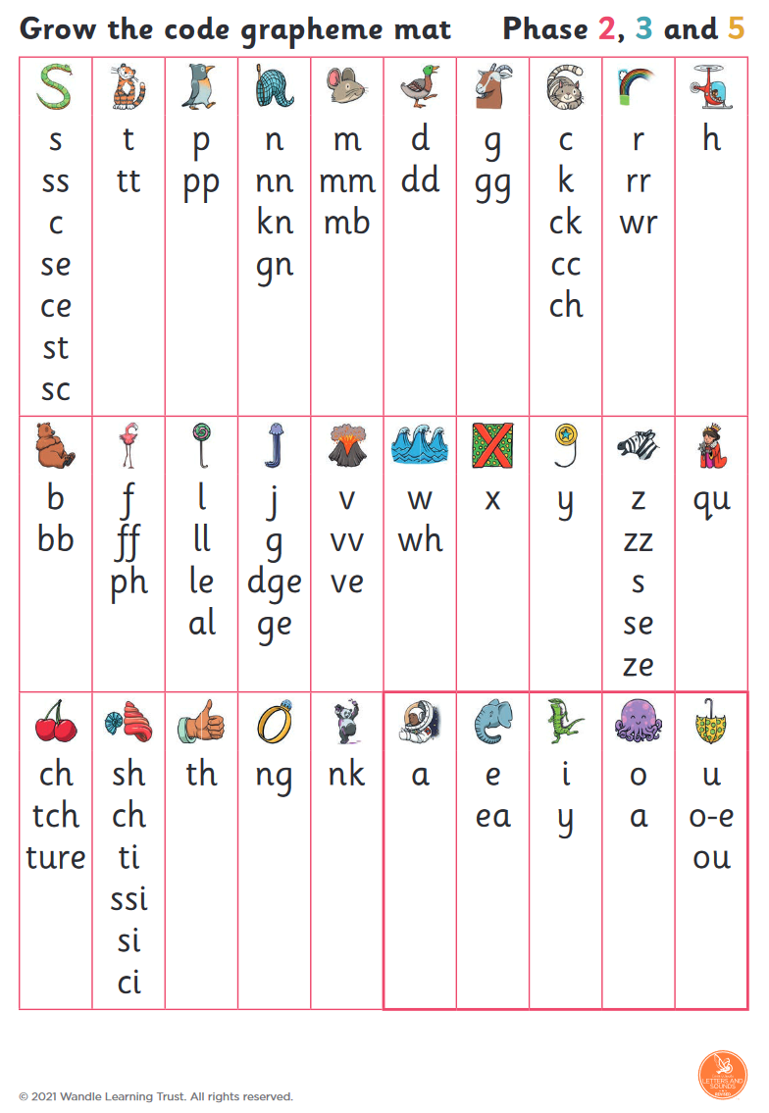
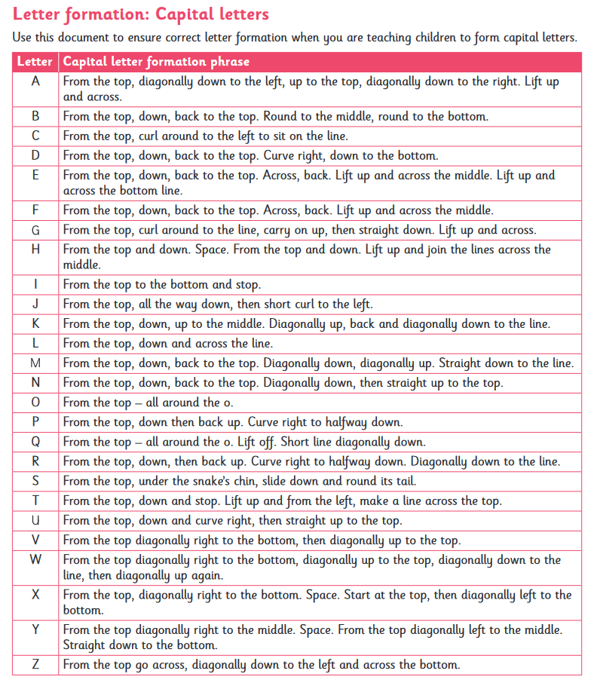
Resources for you at home

