Slide 1


Resilience...
Building Resilience at St. John’s
This year, and especially during our Feeling Good Week,
we are looking at building resilience in our children.
Not only is this a strong thread of our PSHE Curriculum which is taught weekly, we have also identified it as a common need across all year groups and have been working on ways to help all our children build the resilience they need to live life in all its fullness.
This week we will be thinking together about this and so we wanted to share some of the teaching with you as the parents and carers who know our children best!
“I came that they may have life, life in all its fullness.” John 10:10

Slide 2
Resilience...
Feel the feeling
Its only natural to want to protect our children from ever feeling uncomfortable feelings like being sad or disappointed, but this is not real life! As we all know well, we cannot stop things happening that make us feel sad, angry or disappointed, so it is really important to teach our children to notice these feelings, and think about things that help when they feel that way.
You might say: You look sad, do you need a cuddle?
You look like you feel really cross - do you need some space?
“I came that they may have life, life in all its fullness.” John 10:10

Slide 3
Resilience...
Feelings come and feelings go.
Something we teach at St. John’s is that feelings always pass, they aren’t good or bad - they might feel uncomfortable or more pleasant but its not the case that we expect everyone to be happy all the time or that feeling angry is ‘naughty’.
The important thing is what we do when we have these feelings:
What is a safe thing to do when you feel cross?
Who can you share exciting news with?
“I came that they may have life, life in all its fullness.” John 10:10

Slide 4
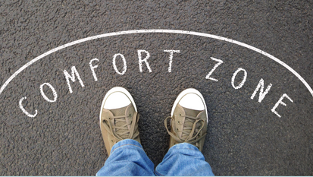
Resilience...
Step outside...
We hear a lot about anxiety and even hear our children saying, ‘My anxiety..’
Anxiety is an important emotion that we all share, it tells us we need to be alert and do something. When it overwhelms us it can force us into
Fight, Flight or Freeze but as part of our normal day it is telling us to get ready for something. Without feeling this and doing the thing any way, we would stay in our comfort zone and miss out on so much!
We love to see our children growing by bravely speaking in Collective Worship, sharing an idea in class, becoming Young Leaders and Buddies or just trying new things for the first time - its how we all live a fuller life!
“I came that they may have life, life in all its fullness.” John 10:10

Slide 5
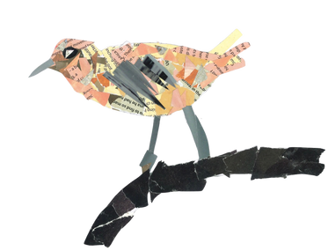
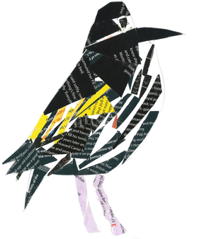
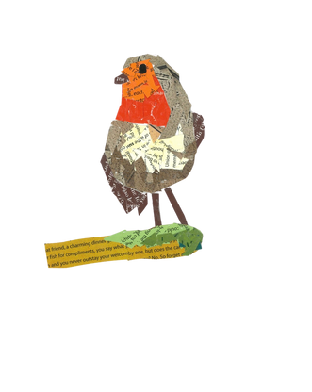
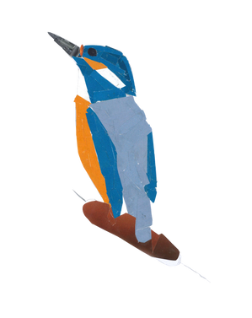
Resilience...
But what if I fall?
...What if you fly?
This speaks for itself, the brave steps we take help us enjoy life more
and flying just fits so well with our newly named classes:
off you go,
Robins, Starlings, Kingfishers and Sandpipers!!
“I came that they may have life, life in all its fullness.” John 10:10

Slide 6

Know your triggers...
Resilience...
...notice the glimmers.
There’s a lot of talk about ‘triggers’, maybe too much?
Of course it is helpful to know things that affect us negatively but what if we switched our focus to Glimmers instead?
A Glimmer is a tiny moment in your day that made you smile or feel good,
we are going to be collecting and displaying these during Feeling Good Week,
see if your children can share some with you...
“I came that they may have life, life in all its fullness.” John 10:10

Slide 7
Helpful links....
Resilience...
If this is something that interests you, have a look at the links below for more.
Please do let us know if you feel resilience is something your child struggles with or if you have found something that works well for them.
St John's Mental Health and Well-Being Page
Nessie In Ed Parent Info
Top 30 Children's Books About Resilience
“I came that they may have life, life in all its fullness.” John 10:10

