Slide 1
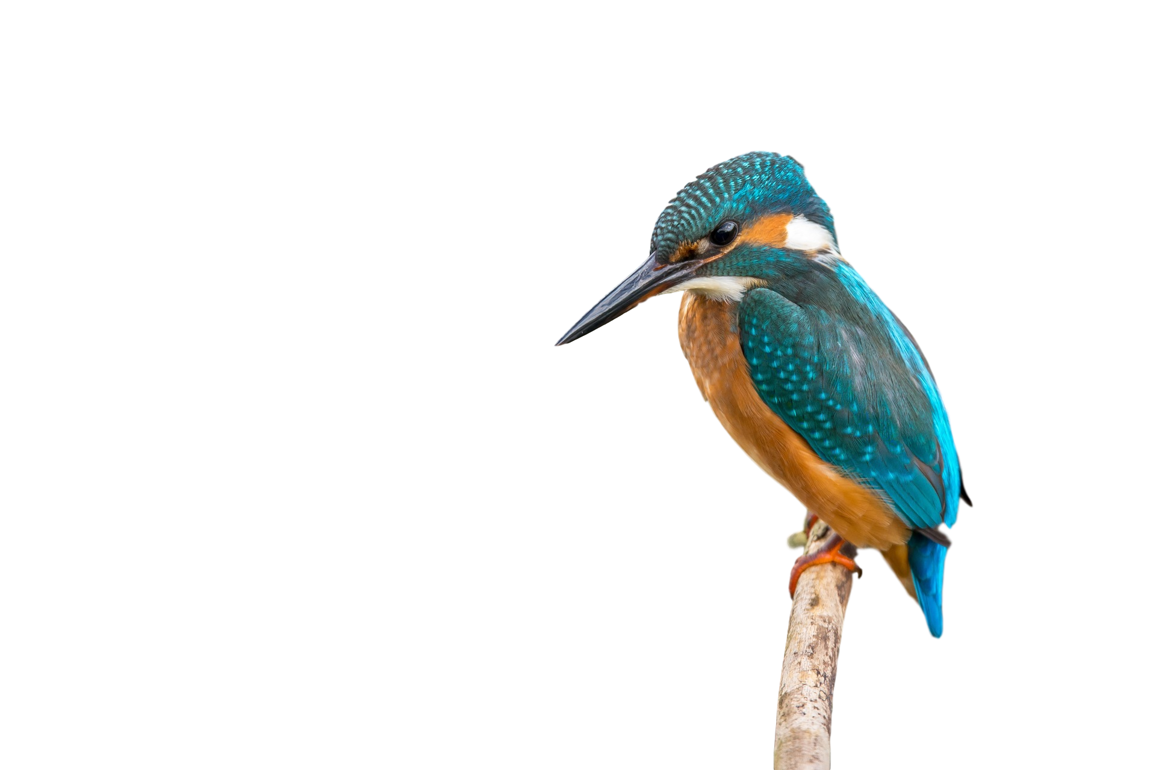
Welcome to Kingfisher class
Mrs Youngs and Miss A
Supported by Miss Gray and Mrs K

Slide 2
Routine
8:40 start to learning – activities as soon as they come in
PE kits for Monday
Forest School – The second half-term of each term on Tuesday afternoons.
Swimming on Wednesday to include swimming hats and goggles (please avoid tights as socks are easier, hair plaited if possible)
Home learning:Thursday – due back Tuesday
Friday – Book of the Week
TTRS – online times table games
Google Classroom
Spellings – given on Thursday , checked on Wednesday

Slide 3
Daily equipment
Reading book & diary, some will have ‘level book’ and a reading for pleasure book
One pencil case
Water bottle
Morning maths / spellings
Named uniform

Slide 4
Uniform
Uniform information on the school website
Please name every item!!
Black shoes or trainers. Trainers must be fully black with no coloured logos/other details.
One keyring per bag.
One pair of stud earrings – no hoops.
No bracelets, anklets or necklaces.
Watches must not have internet access, phone functions or cameras.
Long hair must be fully tied back.

Slide 5
Attendance
As a school, we are aiming for all children to have an attendance rate of at least 95%. If attendance or lateness are an ongoing issue, let’s work together to improve it.
Daily late arrivals, term-time holidays, days out, birthday ‘day off’ etc. all have an impact on children’s socialisation and learning progress as well as missing out on exciting opportunities in school.
Where possible, please ensure appointments are booked outside the school day. For appointments during the school day, please send suitable evidence to the office.

Slide 6
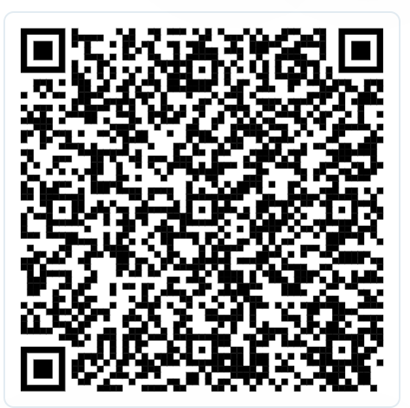
Free School Meals
Is your chid eligible for Free School Meals? It enables the school to receive additional funding to support all children. Children can also attend free local camps and events in the school holidays.
We can help you with your application – arrange a time to pop into the school office or to meet with Mrs Boylan or Mrs Gammon.
Click here to make an application on Herts County website

Slide 7
Expectations
Teamwork – in talk partners, groups and various roles
Respect – for others, equipment, themselves
Presentation including handwriting– to take pride in their work and learning
Personal responsibility – organising themselves, remembering equipment, passing on letters, remembering kits
Role model – setting an example of our values and behaviour expectations
Attendance

Slide 8
Friendships
Responsibility for behaviour
Growing in maturity
How do we make amends and react better next time?
Please let us know if your child is concerned about a friendship, or feels they are being treated inappropriately by others
In preparation for residentials, consider sleep-overs!

Slide 9
Help at home
Supporting home learning
Helping with organisation
TT Rockstars
Reading
Positive mindset and promoting resilience
Clubs – great for skills building
Topic webs (school website)

Slide 10
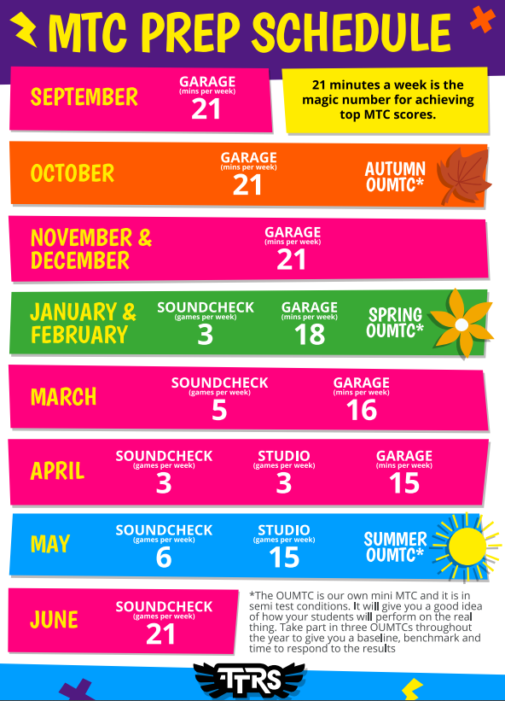
MTC
What is the Multiplication Tables Check?
The checks consist of 25 times tables questions. The questions will only be multiplication, and they will go up to 12×12.
There will be 6 seconds to answer each question.
The check will be taken online during school time.
There is no pass mark.
But why are times tables so important? Having rapid recall of times tables makes other areas of maths much easier. Having the tables secure frees up their working memory for newer, more challenging tasks at hand.
In the two-week period beginning June 2027

Slide 11
Additionally, the following links below are helpful to practice for the MTC:
Super Movers: Times Tables Collection
https://www.youtube.com/@MrWalkerMrWalker (times tables songs)
Daily 10 - Mental Maths Challenge - Topmarks
Hit the Button - Quick fire maths practise for 6-11 year olds
Year 4, Key Stage 2, Practice Times Tables Tests (Multiplication Tables Check)
MTC - Multiplication Tables Check - URBrainy.com
https://www.timestables.co.uk/

Slide 12
Contact
Through the office – 01707 322589 or admin@stjohns561.herts.sch.uk
A note via your child
A meeting before or after school (grab me at the classroom door at 3:15pm to organise!)

Slide 13
Thank you for your time

