Slide 1
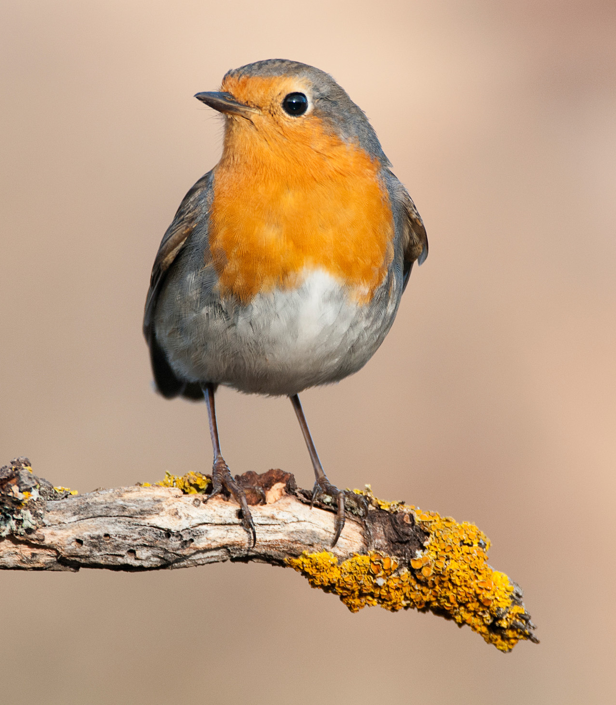
Welcome to Robins
With Miss Mockford, Mrs Redmond,
Mrs Hoad, Mrs Simone and Miss Wallace

Slide 2
Routine
8:40 start to learning – busy fingers
Saying good-bye to parents at the playground door from now.
PE kits – PE is on a Monday. Children will work up to changing into their full PE kit and, initially, children will go home in their PE kits on Monday with their uniform in their bag. Please make sure that the kit is returned by the Friday. We will eventually change back into our uniform and PE kits will stay in school and be sent home every half term.
Home learning:
Reading at least 5 times a week. Adults to comment on how they did in Reading Record. Home learning opportunities on MTPs. First homework of photos already sent out.

Slide 3
Expectations for Robins
Teamwork – in talk partners, groups and during child-initiated learning
Respect – for others, equipment, themselves, the school,
Presentation – to take pride in their work, to explore the setting which may include a little mess! Remember to wear their outside clothes, wellies and aprons.
Handwriting – Practising pattern formation and correct letter formation.
Personal responsibility – organising themselves, remembering routines, remembering their belongings, giving things a go before asking for help.

Slide 4
Tapestry
Observations will be placed on this system to show what your child is learning at school.
Used as a way of communicating about upcoming events and notes from school – please check regularly.
Please add any life events or special occasions onto Tapestry for children to share with the class.
For your own personal use – please do not share outside your household.

Slide 5
Things to remember everyday
School bag with reading record and book in.
Jacket/Coat – even on hotter days (the British weather is unpredictable!)
Water bottle
Library books (on a Monday)
Please label everything!
PE kits, waterproofs and wellies (to stay on peg in school- in a name bag please) We will send home once a term to check it all still fits well.

Slide 6
Medical needs in Robins
Let us know if anything changes regarding your child’s health.
Will need to know about illnesses as there are some medically vulnerable children in the school – eg: temperatures, colds, chicken pox, slap cheek, etc… and follow national health guidance on when to keep children off school for illnesses.

Slide 7
Help at home
Encouraging independence with dressing, toileting and eating.
Practise letter sounds and reading daily – pure sounds only please!
Encourage drawing and mark making including outside chalking.
Recognising numbers in the environment, counting out objects eg: setting dinner places
Encourage building upper body strength – monkey bars, climbing, pilates poses.
Fine motor skills – bottle lid twisting, threading, pegs, picking up coins from a table, posting buttons through a hole, pencil control

Slide 8
Important messages
Screen time- advice is currently up to 1 hour of screen time for 3-5 year olds per day. We will limit this at school, using them with an adult when helpful for learning.
Attendance at school makes a big difference for children. If you have appointments, please send details to the office. Please book holidays outside of term time, often ends of terms they miss special events and learning through the year.
Pupil premium- please look at applying if you might fit the criteria- it makes a difference in school.

Slide 9
Upcoming dates and meetings
Flu vaccinations – Monday 21st September
Little City Role Play– Wednesday 23rd September
Harvest service at St John’s Church: Thursday 8th October
Parents’ Evening (face-to-face): Tuesday 13th October
Parents’ Evening (face-to-face/online): Thursday 15th October
Children in Need Day: Friday 13th November
Occasional day (children not in school): Friday 27th November
Christmas Panto: Tuesday 8th December
Christmas Nativity: Thursday 10th December (9:15am/2:15pm)
Termly music performance: Tuesday 15th December/Tuesday 23rd March/Tuesday 20th July
Carol Concert: date tbc
Lemsford Fete: Monday 3rd May- Do keep this free!
End of terms finish at 1:30pm

Slide 10
Contact
Through the office – 01707 322589 or admin@stjohns561.herts.sch.uk
Speak to Mrs Boylan on the gate- any messages will be passed on
A note via your child/on Tapestry
A meeting before or after school
Or just grab us at the classroom door at 8:40am and 3:10pm
Please think which of these will work best

Slide 11
Thank you for listening
Any questions?

